Slide 1
Random Forest Classifier model

Slide 2
Introduction
What is random forest classifier?
A random forest classifier is a machine learning algorithm that uses multiple decision trees to classify or regress data:
Random Forest algorithm is a powerful tree learning technique in Machine Learning. It works by creating a number of Decision Trees during the training phase.

Slide 3
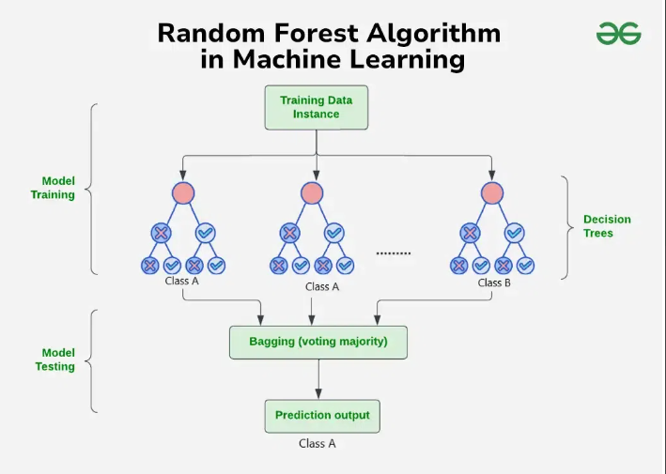
How Random forest model works
A random forest classifier is a collection of decision trees that are trained using random noise. The algorithm uses two sources of randomness to ensure the independence of the trees:

Slide 4
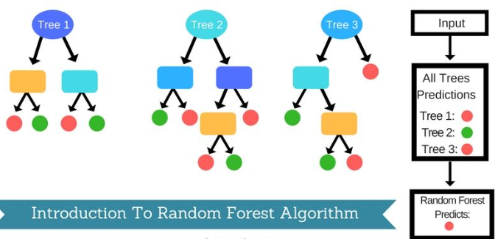

Slide 5
Objectives in Random forest model
1) Reading of data.
2) Exploratory data Analysis(EDA).
3) Interprete with graphs using seaborn and matplotlib packages.
4) Data splitting for testing and training.
5) Data modelling for training,testing and fitting the variables in model.
6) Prediction and evaluation on predicted data.
7) Check Accuracy score.
8) Check Confusion matrix.
9) Feature importance for plotting data.

Slide 6
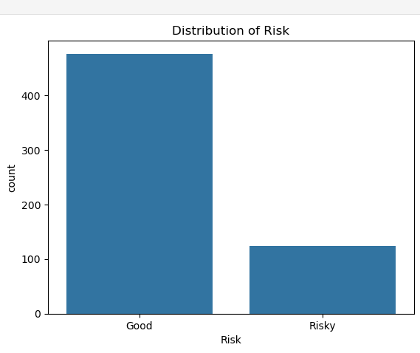
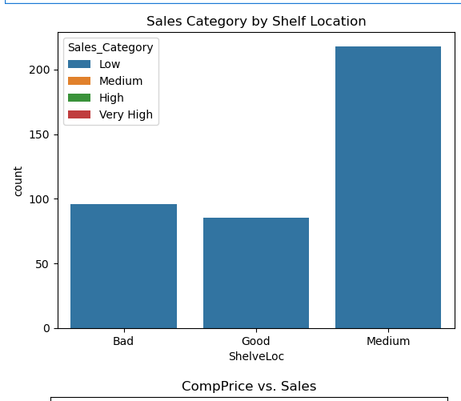
Solutions
For reading data define read_data() function and call pd as pandas package.
For EDA check dataset is clean by using df.isnull()sum(), data_types, describe function, import seaborn and matplotlib.pyplot packages, define and call the function plt.figure() for ploting graphs and plt.show() for display the graph.

Slide 7
Solution
Use corr() function for showing correlation between features and categorical target variables. i.e. Categoty_sales and Risk.
For data splitting define X_train ,X_test,y_train and y_test variables and call train_test_split() function.
In data splitting process, slits the data as an ratio of 70:30, 70% of data use for data training model and 30% of data use for data testing mode.l
For data modelling call Random forest classifier(), fit.model() for fit the variable X-train and y_test for Model Training.

Slide 8
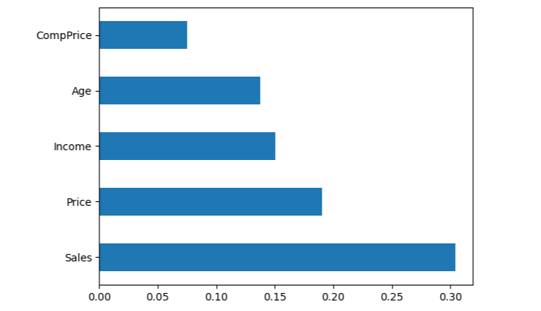
For data prediction call model.predict() function
For checking Accuracy score used,
accuracy_score(y_test, predictions) function.
For checking Confusion matrix used,
confusion_matrix(y_test, predictions) function.
For plotting data feature importance used model.feature_importances i.e. Graph for Company_data

Slide 9
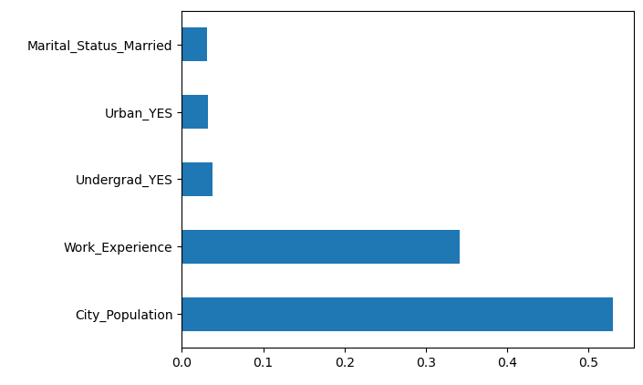
For plotting data feature importance used model.feature_importances i.e. Graph for Fraud_check dataset

Slide 10
Bussiness impact of Random forest
The Random Forest algorithm can effectively increase the accuracy of the prediction results without significantly increasing the computational effort.
it has the property of being insensitive to multivariate linearity, which maintains the stability of the results.
It has been applied across a number of industries, allowing them to make better business decisions.
Some use cases include: Finance: It is a preferred algorithm over others as it reduces time spent on data management and pre-processing tasks.
its scalable and it has ability to handle large data sets.

Slide 11
Customer churn prediction: Businesses can use random forests to predict which customers are likely to churn (cancel their service) .
Business Analytics using Random Forest Trees for Credit Risk Predictions.
It can also provide accurate predictions without needing to be tuned for each data set.
It is also relatively easy to implement, as it is a non-parametric method that does not require any prior assumptions about the data.
Random forests can measure feature importance and provide insight into which variables have the most influence on the outcome.
Random forests an attractive choice for solving business problems.

